Slide 1
Parent consultation
Responses to RSHE parent consultation
January 2021

Slide 2
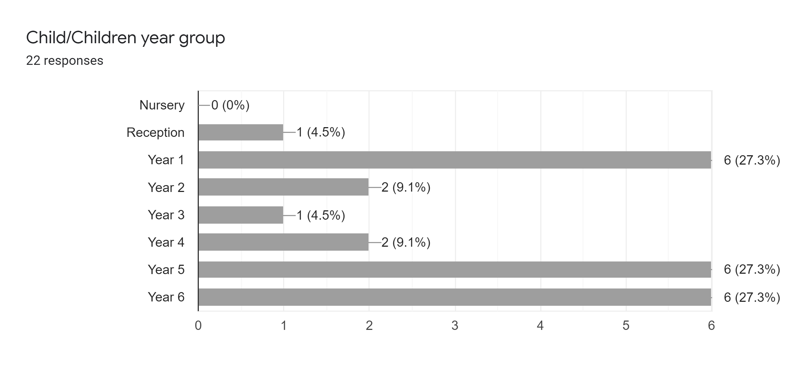
Year Group response
Total of 22 responses
8%
Represents 19 different families
Year 1, 5 and 6 most responses.

Slide 3
Section 1
Life to the Full - General
A series of statements were presented in the survey and the choice of responses was as follows;
Strongly Agree
Agree
Undecided
Disagree
Strongly Disagree

Slide 4
Section 1 life to the full - general

Slide 5
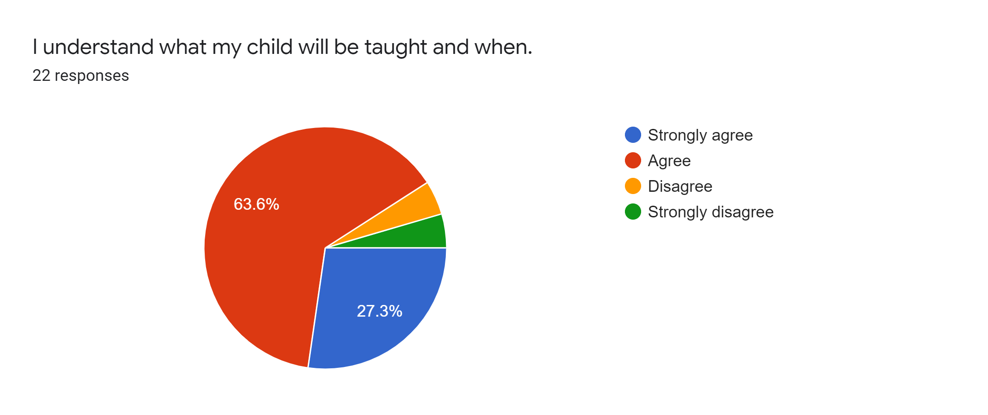
Statement 1
91% Agree or strongly agree

Slide 6
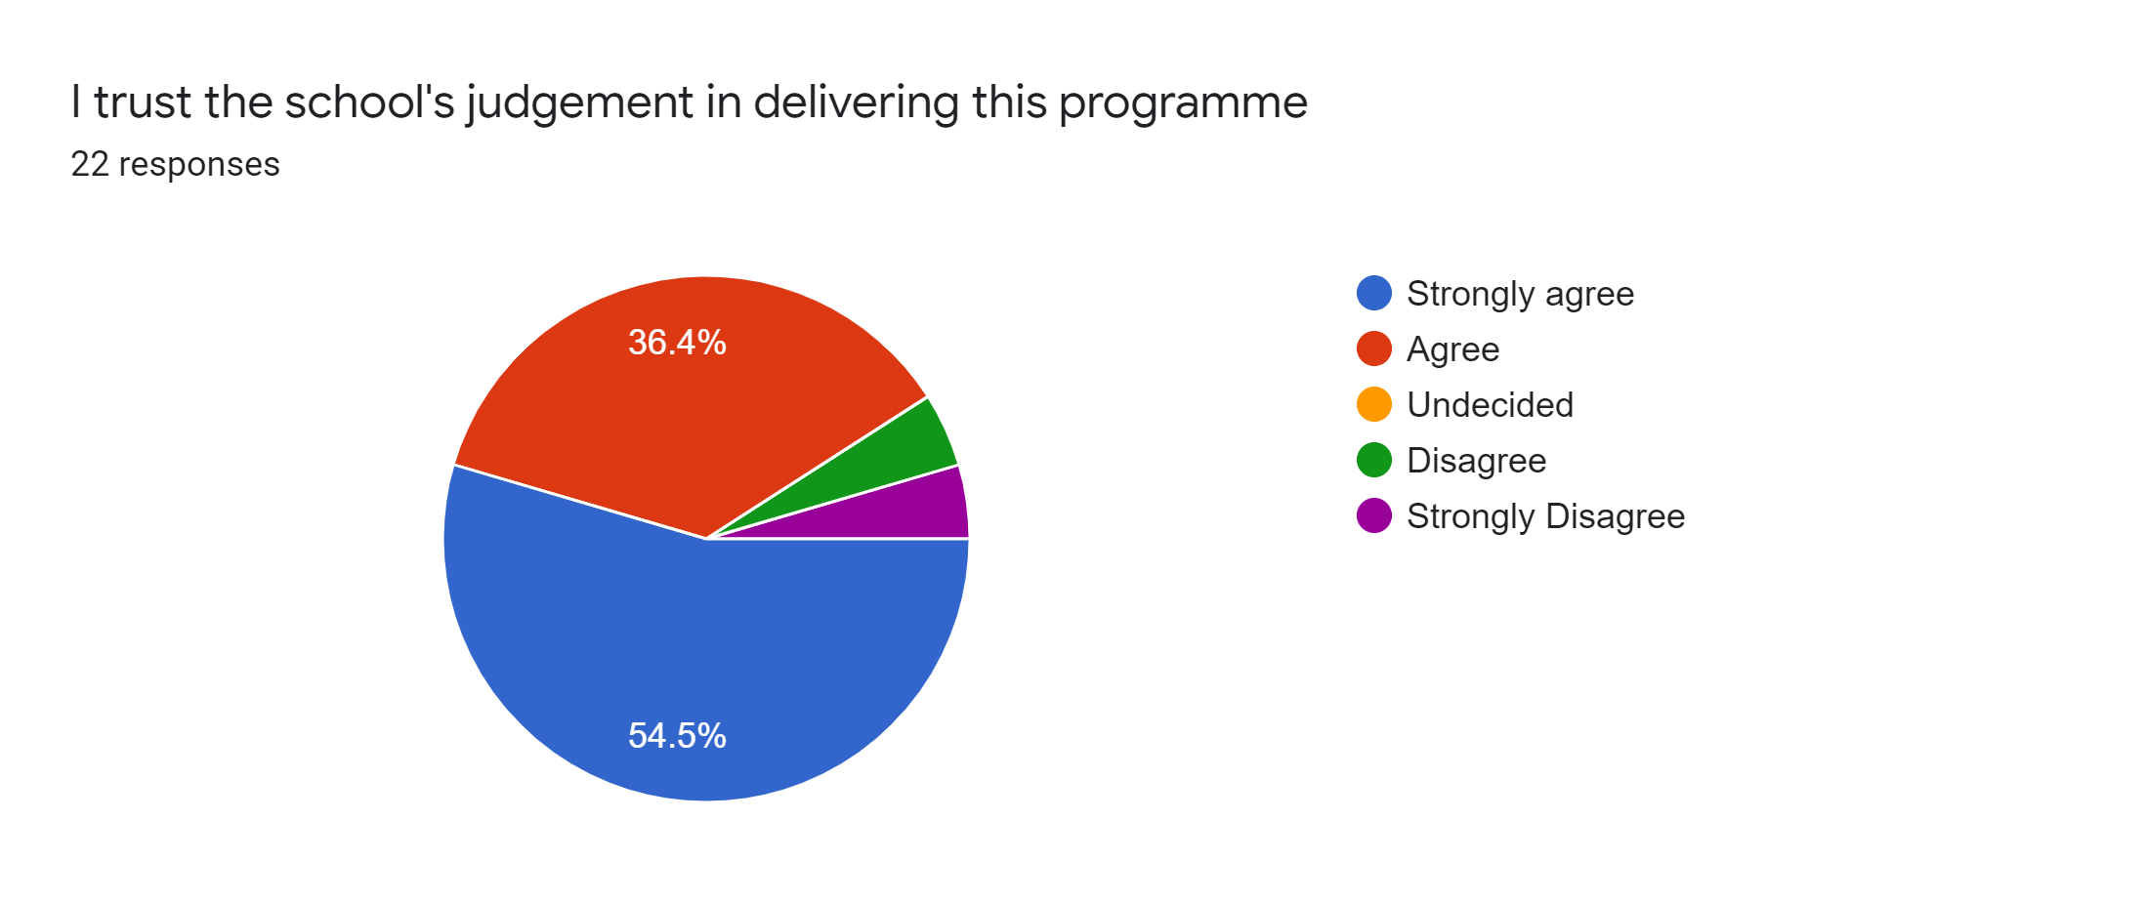
Statement 2
91% Agree or strongly agree

Slide 7
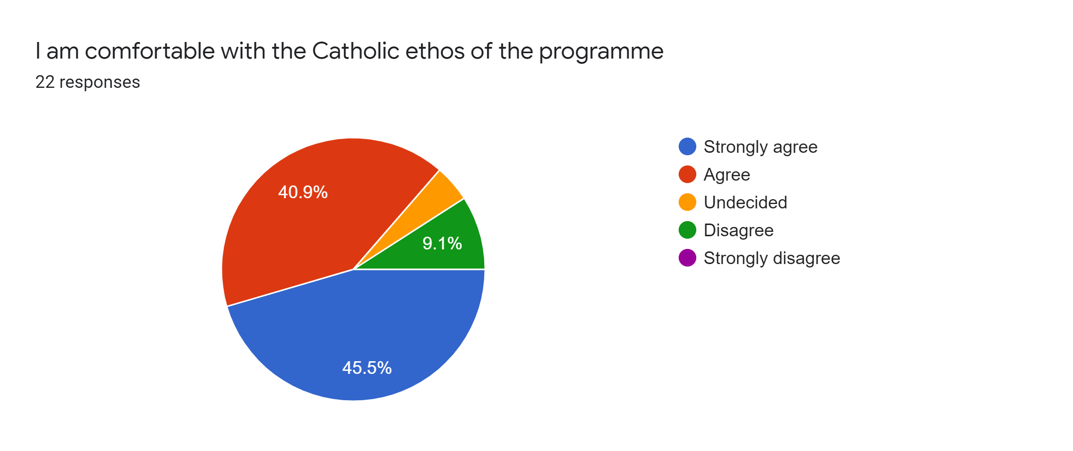
Statement 3
86% Agree or strongly agree

Slide 8
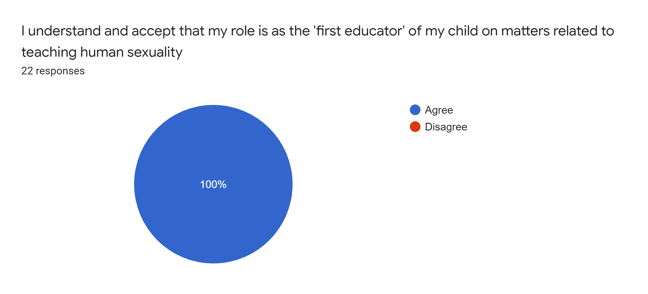
Statement 4
100% Agree

Slide 9
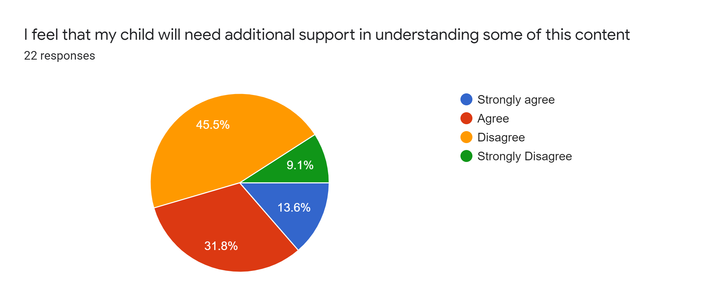
Statement 5
45% Agree or strongly agree

Slide 10
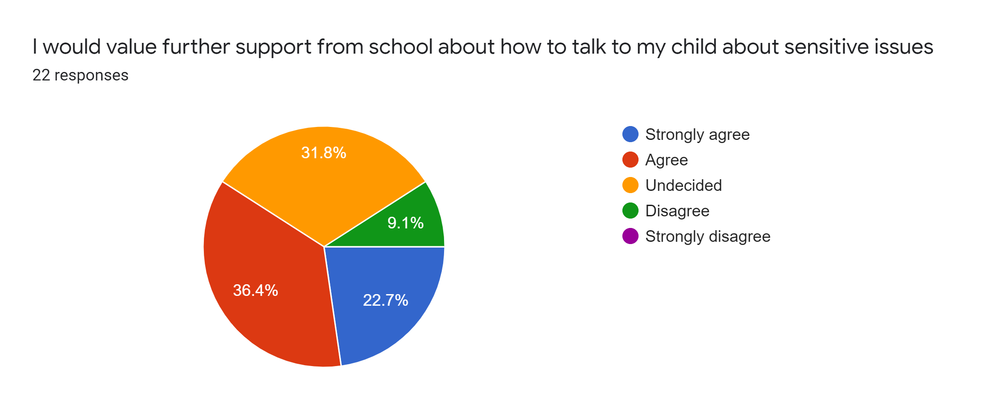
Statement 5
59% will require additional support

Slide 11
Comments from section 1
I will appreciate any support provided. Thanks for your continuous support always.
I fully support the teaching of relationships and health education at school, as per statutory requirement. I would also support the school in teaching age appropriate sex education. I would prefer boys and girls to be taught RHSE together as much as possible, to normalise the use of language and to encourage a respectful understanding of each other and the development of healthy relationships. This seems like a reasonable programme. It is important that it has been approved by the DfE.
I think for 8 years old kids its too early speak about human sexuality. But because its mandatory, I will support school lessons, and will talk with my daughter at home about it.
We have a very open conversation at home.

Slide 12
Section 2
Key Decisions

Slide 13
External Genitalia at Key Stage 1
71% approve

Slide 14
Year 4 is a good time to learn about Puberty
68% approve

Slide 15
Sexual intimacy in Year 6
96% approve

Slide 16
Pornography as internet safety
85% approve

Slide 17
Pornography as a way people are ‘used’
67% approve

Slide 18
Parents comments for section 2
I strongly disagree about educating children in primary school about sex education. They are to young. What is the world coming to. I think educating children to early about sex education will take away there innocence and encourage them to be sexually active at early age. The world has gone crazy. Especially at a catholic school children should be thought to wait until marriage. I will be praying this does not come to my child’s school. I will also be praying for all the children being made to learn this in primary schools. Very sad.
I don’t think that pornography should be discussed at this stage
Don’t agree that children need to know anything about pornography just basic sexual education is fine
I think for this year group its too early to talk about pornography

